Slide 1

SAP Build Process Automation Day 2
Deloitte Consulting LLP
Notes:
A basic Operate/AMS presentation to take clients through our thoughts on operate.
Owner: TBD
Last Updated: 02/09/2018
Change log
V1.0
Color palette updated.
Fonts adjusted and resized.
Inverter test completed.
Cover image made transparent.
New text & Shape test passed.
Speaker notes reviewed and cleansed.

Slide 2
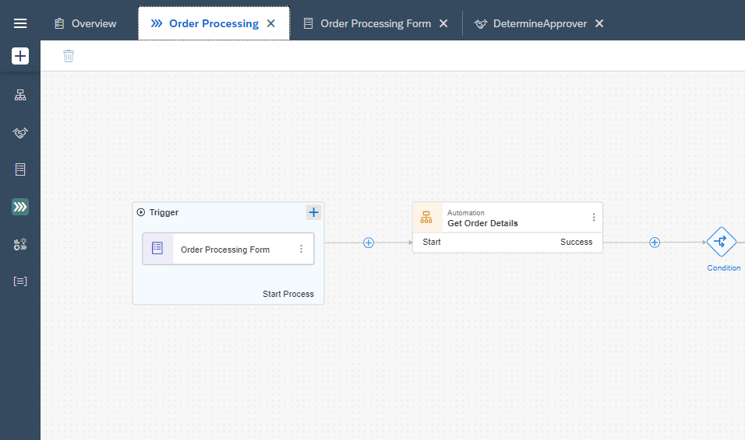
Agenda for Day 2
Desktop Agent
Workflows/Business Process in SAP BPA
Process Automation
Trigger and Monitor

Slide 3
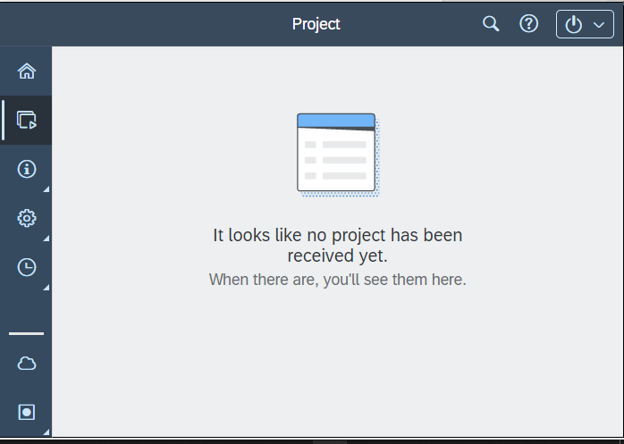
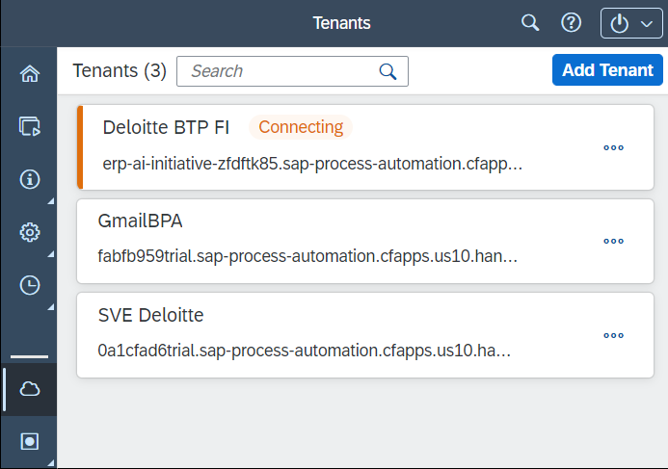

Desktop Agent Set up
Desktop Agent will be used to connect SAP BTP account to the machine to run and monitor the BOTs developed.
01
Download Desktop Agent from below link
SAP Development Tools (ondemand.com)
02
Configure
Follow the steps in this TUTORIAL to configure your Desktop Agent on Local Machine
03
Ready to Trigger process automation from SAP Build
Now add triggers to the developed project and execute from Desktop Agent
Guide

Slide 4

Journey So Far
Trial Account Setup
Roles Addition to Account for Build
SAP BTP
Subscription to SAP Build Process Automation
Install Desktop Agent and Add Tenant

Slide 5
Tools available for Workflow Business Processes
For any Automation/Process below tools can be utilized to enhance the workflow/process.
Forms Set of fields that can be submitted to trigger next step Can be used as a trigger for Business process Easy to build using Drag and Drop features Used to instantiate any process Mandatory/Optional fields Can be reused in the process
Approval Forms Number of fields can be entered for the approver to decide on the approval request Used in between the business process User can approve and reject based on the set of data Mandatory/Optional fields can be provided Used to trigger different flow as per approval/rejection
Automation Task automation can be created/used within the business process to automate any recurring/manual task. Plays an important role in any SAP BPA Project Can have trigger as an API and can also be used within a business process Can be debugged on the way by viewing the timeline
Decision Used to define business rules decisions in a specific decision table with curtails inputs and deriving outputs out of it. Major role in approval related workflows Inputs parameters are a pre-requisite to implement this Create a decision to determine approvers who will be authorized to approve sales order based on complex rules.

Slide 6
Tools available for Workflow Business Processes
Contd….
Mail To trigger emails based on any particular trigger or action. Easy drag and drop simplicity to configure email Pre-defined variables can be leveraged to design email. CC, BCC users can directly be added.
Visibility Scenario To measure success and improvements. Can be used with track down the execution and improve accordingly
Controls Branch or switch statements. IF, Else Branch Wait
Action APIs can directly be used within the business process workflows.

Slide 7
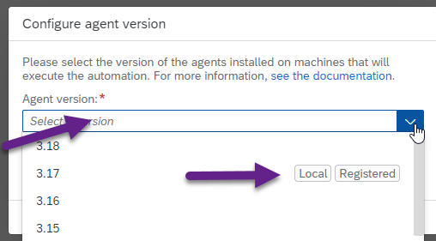
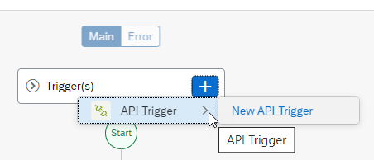
Process Automation
It helps to automate repetitive or tasks that involve higher volume of manual efforts
Select your agent version when creating new Automation
Give name and description for the Automation project
Selection Trigger as API
Configure your inputs to build the API inputs
Go ahead to use drag and drop features for the Automation design.
Manual Task
Repetitive
Drag & Drop
Error Free Run

Slide 8
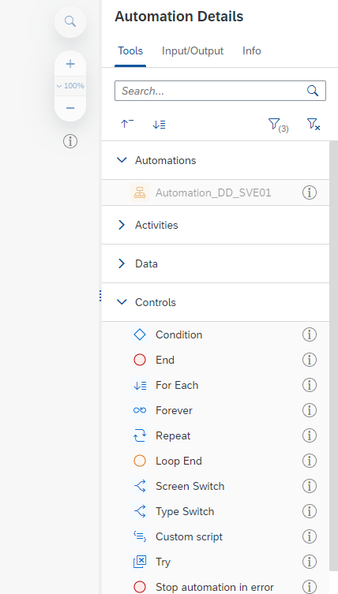
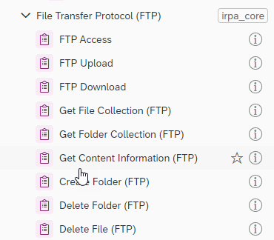
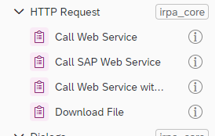
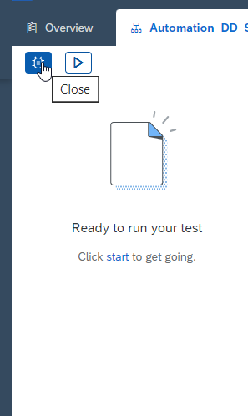
Process Automation
Tools available to design automation
Out of SDKs there are couple of tools available for automation like JS to XML and XML to JSON converters and others as well
HTTP requests can be handled
File transfer can be handled
S4 connectivity can be achieved to trigger processes in SAP
Timeline can be monitored during execution for debug purpose

Slide 9
Process flow for Automation
1
Create Project from Lobby
2
Design and Save
3
Update SDKs
6
Execute & Monitor
5
Deploy
4
Release

